Slide 1
Machine Learning in Azure

Slide 2
IoT PoC Architecture
Our original discussion. Delivering data to the Legacy IaaS Network (also called the Critical Data Zone) could be problematic with the requirements / firewalls involved in that zone.

Slide 3
IoT PoC Architecture
An alternative, where IoT Hub can be installed on-prem.

Slide 4
IoT PoC Architecture
alternative
This alternative also requires sending data across the Legacy IaaS Network / Critical Data Zone barrier. Further, the KafkaConnect would have to be configured / altered to attach to the Kerberized Kafka service

Slide 5
IoT PoC Architecture
alternative
This alternative does not require sending data across the Legacy IaaS Network / Critical Data Zone barrier. The Cloudera cluster would have to be given access to the Blob storage location where the IoT Hub lands the data. The storage account could also be attached to the Cloudera Network, via a Service Endpoint. The IoT data would follow the data ingress pattern currently used for other data in the Cloudera Cluster.

Slide 6
IoT PoC Architecture
alternative
This alternative builds on the previous one, just calling out various other PaaS services available to be able to shape, analyze, report over and reason over the data.

Slide 7
Objective
Equip each student with the Azure machine learning tools they can apply immediately
In the words of RW Murphy:
Slightly overwork the student who has average familiarity with the material
While not discouraging students who are brand new to the material
And still challenging the students who are more familiar with the material

Slide 8
Agenda
Day 1
Setting up your Data Science VM to work as your portal into the Azure Machine Learning service and MLOps for data science
Azure Machine Learning service
Data prep
Model training
Model training on Azure ML service compute
Model operationalization – including deployment and monitoring
Azure Databricks
Workspace setup / cluster setup / Python ADB intro / RDD vs Dataframe vs Dataset
Data prep / Model training
Model operationalization
Homework assignment / recap / Q&A
Day 2
Azure Databricks continued – special guests Terry and Ron from Databricks, live via satellite from the DFC
Cognitive Services
Image classification
Handwriting recognition
Azure ML Studio
A quick introduction on the tool for the citizen data scientist
Model training
Model operationalization
More on the Team Data Science Process and MLOps
Wrap-up next steps

Slide 9
Best practices
Shut off your DSVM from the portal any time you’re not using it
Set up an auto-shutdown rule for the DSVM just in case
For the cautious: before shutting down DSVM
Save all notebooks
Go to the running notebooks tab and shut down any running notebooks
Click into the command window that runs the notebooks and control-c
Be sure your AZ ML compute have min cpu = 0 (auto shutoff)
Be sure your Azure Databricks clusters have an auto shutdown time and use autoscale 1 worker min – n workers max
This deck and other materials are available at:
http://github.com/delbert/azml

Slide 10
Setting up Azure Machine Learning service
Create AzureML workspace in Azure portal
Create Resource Group: initials + Mlws
Create Workspace: initials + Workspace
Create DSVM (let’s all do Windows 2016)
Resource Group: initials + DSVM
VM: initials + DSVM
After VM is created, create a DNS name: initials + DSVM

Slide 11
Setting up Azure ML - DSVM / Linux
In JupyterHub (https://dsvm.ip:8000) / terminal
cd notebooks
git clone https://github.com/Azure/MachineLearningNotebooks.git
cd ...
/data/anaconda/bin/conda create -y -n aml Python=3.6
source /data/anaconda/bin/activate aml
pip install azureml-sdk[automl] ipykernel
/data/anaconda/bin/conda install -y cython matplotlib pandas
pip install azureml-widgets
python -m ipykernel install --user --name aml --display-name aml
switch JupyterHub kernel to aml

Slide 12
Setting up Azure ML - DSVM / Windows 2016
In CMD prompt
cd notebooks
git clone https://github.com/Azure/MachineLearningNotebooks.git
cd ..
conda create -y -n aml Python=3.6
conda activate aml
conda install -y cython matplotlib pandas
pip install azureml-sdk[automl] ipykernel
pip install azureml-widgets
python -m ipykernel install --user --name aml --display-name aml
start JupyterLab notebooks
switch JupyterLab kernel to aml when prompted

Slide 13
Azure ML exercises
Configure
Open configure.ipnb - set kernel to aml (+ quick intro to notebooks)
Check version number, cell [1]
Set parameters from AzureML workspace, cell [2]
Save config file, cell [3]
Data Prep
Open tutorials/regression-part1-data-prep.ipnb - set kernel to aml
For each cell
Read over the description and code
Execute the cell
Check out: transforming dates by example
Check out: each transformation is saved as a step in a transformation pipeline
Model Training - AutoML
Open tutorials/regression-part2-automatedml.ipnb - set kernel to aml
For each cell
Read over the description and code
Execute the cell
Walk through Azure portal Azure ML service Workspace
Check out: Experiments, the AutoML run, etc
Check out the next slide, on how AutoML works

Slide 14
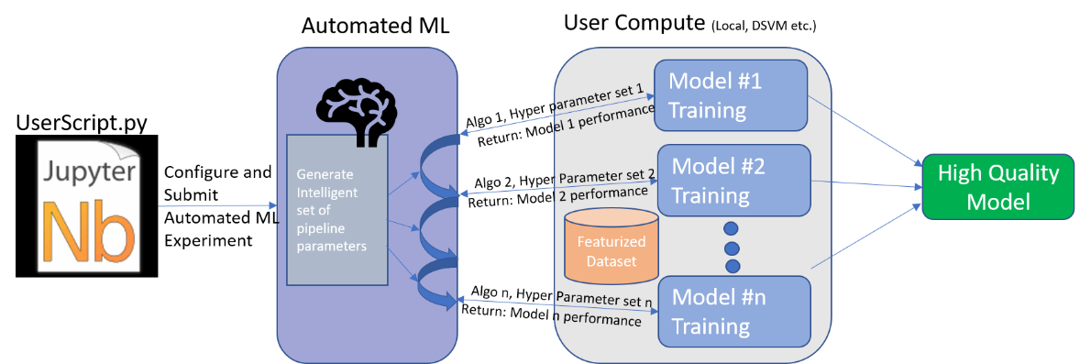
How AutoML works

Slide 15
Fixes
Fix for plot in regression-2:
fig = plt.figure(figsize=(10, 7))

Slide 16
Azure ML challenges
Can you cancel an experiment?
Can you splunk through the various elements in the Workspace, by iterating through them?
Can you add an extra feature to the Taxi dataset called crow_flies_distance and calculate it from lat/long?
Can you use the Python dprep toolkit to automatically one-hot encode a categorical variable?
https://docs.microsoft.com/en-us/azure/machine-learning/service/how-to-transform-data

Slide 17
Azure ML exercises
Model Training with Azure ML Compute
Open tutorials/img-classification-part1-training - set kernel to aml
For each cell
Read over the description and code
Execute the cell
Check out Workspace / storage account for uploaded data
Check out Workspace / Experiments for run info, uploaded model, logs
Model Deployment with Azure Container Instances
Open tutorials/img-classification-part2-deploy - set kernel to aml
Skip the first cell
For each cell
Read over the description and code
Execute the cell
Check out Workspace / Images to see the deployed model -> docker image
Check out Workspace / Deployments to see the deployed model running
Be sure to execute last cell, to delete ACI deployment
Double-check Workspace / Deployments to be sure deployed model is shut down

Slide 18
Azure ML challenges
Are you familiar with the Template Method design pattern? How is it used when you train your model with Azure ML Compute?
What do you do if you want to create a deep neural network with PyTorch or TensorFlow and train it on a TB of data?
Can you add monitoring via App Insights to the deployed model?
https://docs.microsoft.com/en-us/azure/machine-learning/service/how-to-enable-app-insights
Can you collect data on how well your model is performing?
https://docs.microsoft.com/en-us/azure/machine-learning/service/how-to-enable-data-collection

Slide 19
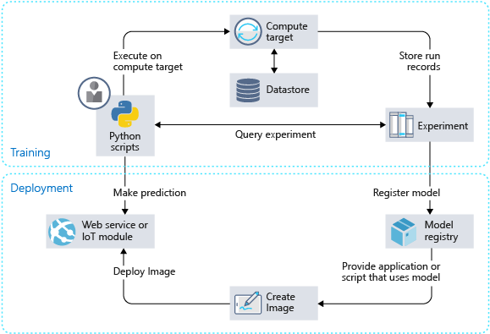
How the Azure ML service works
Develop machine learning training scripts in Python.
Create and configure a compute target.
Submit the scripts to the configured compute target to run in that environment. During training, the scripts can read from or write to datastore. And the records of execution are saved as runs in the workspace and grouped under experiments.
Query the experiment for logged metrics from the current and past runs. If the metrics don't indicate a desired outcome, loop back to step 1 and iterate on your scripts.
After a satisfactory run is found, register the persisted model in the model registry.
Develop a scoring script.
Create an image and register it in the image registry.
Deploy the image as a web service in Azure.
https://docs.microsoft.com/en-us/azure/machine-learning/service/concept-azure-machine-learning-architecture

Slide 20
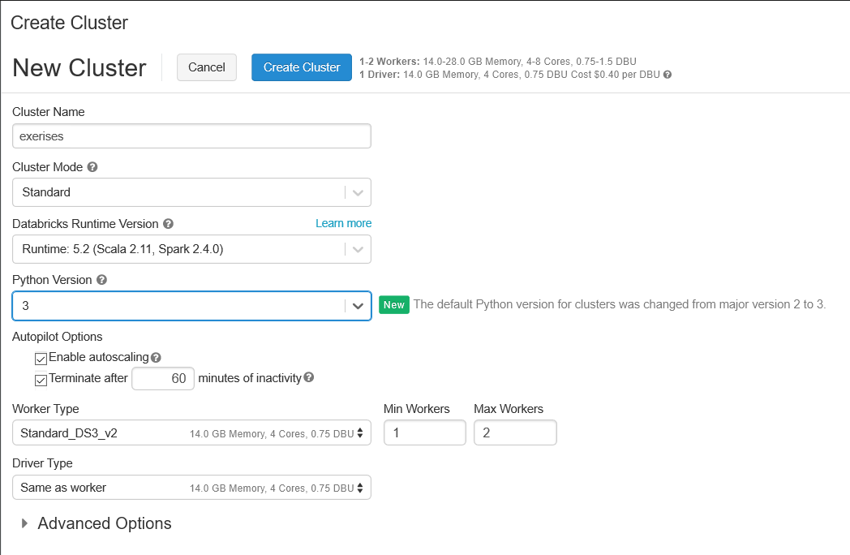
Setting up Azure Databricks
Create Azure Databricks workspace in Azure portal
Launch your workspace
Import notebooks
Home>userid>import>URL>
https://docs.azuredatabricks.net/_static/notebooks/getting-started/quickstartusingpython.html
https://docs.databricks.com/_static/notebooks/getting-started/popvspricelr.html
https://github.com/delbert/azml/blob/master/ip21.dbc
https://docs.azuredatabricks.net/_static/notebooks/mleap-model-export-demo-python.html
Create a Databricks cluster
Clusters>+Create Cluster>

Slide 21
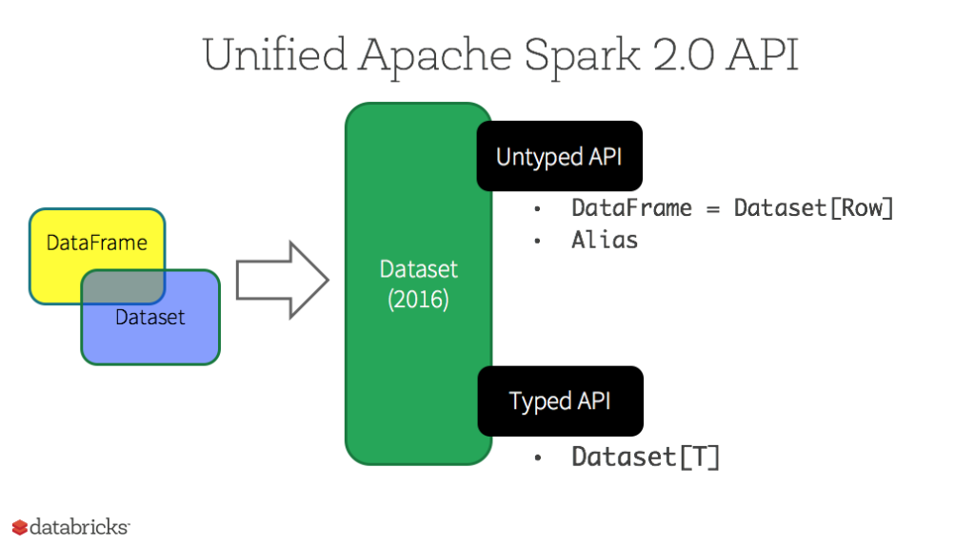
Azure Databricks exercises
Getting started
Workspace>userid>Quick Start Using Python
For each cell
Read over the description and code
Execute the cell
In Python and R, we work with DataFrames
Difference between RDDs, DataFrames, and Datasets
Resilient
Distributed
Dataset
All of these are immutable, but this
changes with Delta.

Slide 22
Azure Databricks exercises
Doing regression on home prices, based on population
Workspace>userid>Pop vs. Price LR
For each cell
Read over the description and code
Execute the cell
Work with IP21 data and Spark SQL
Workspace>userid>ip21
For each cell
Read over the description and code
Execute the cell
Notice the magic: %sql to invoke Spark SQL
Notice creating an external table first, then once column conversions are set, create table as select (CTAS)
Finally, notice the different charting/graphing options for formatting output cells

Slide 23
Azure Databricks exercises
Operationalize Model
Workspace>userid>MLeap Model Export Demo (Python)
For each cell
Read over the description and code
Execute the cell

Slide 24
Azure Databricks challenges
Do you have a use case for Cosmos DB + ADB?
(hint: large-scale data injestion, perhaps from Power Inverters?)
(hint2: see next slide)
Check out MMLSpark – can you create an MMLSpark cluster and try out the sample notebook?
http://aka.ms/spark
https://github.com/Azure/mmlspark/
If you need to create a deep neural network and train it on PyTorch or TensorFlow in ADB, how would you do it?

Slide 25
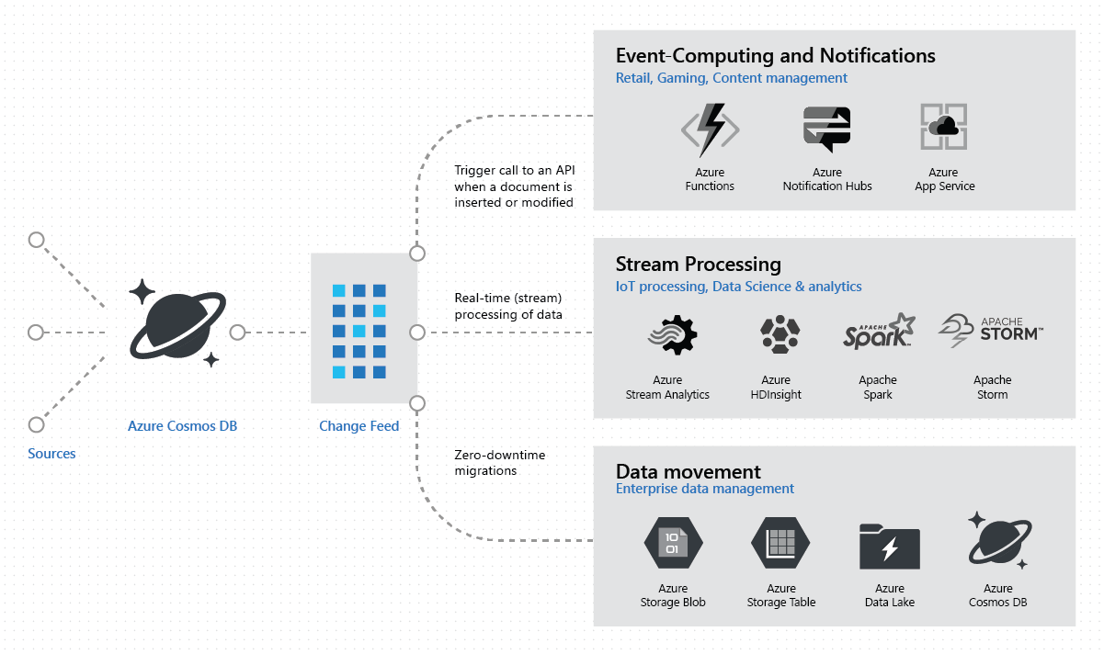
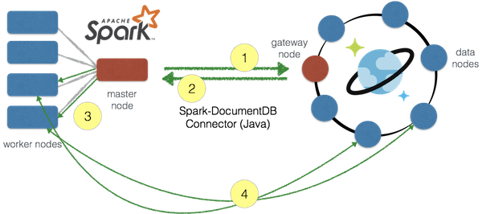
Other Azure Databricks topics
Azure Cosmos DB connector for Spark
https://github.com/Azure/azure-cosmosdb-spark#using-databricks-notebooks
Includes flight predictions example and a change feed example, among others

Slide 26
Cognitive Services / Knowledge Mining

Slide 27





Cognitive Services capabilities Infuse your apps, websites, bots, and machine learning pipelines with human-like intelligence
Vision
Speech
Language
Knowledge
Search
Object, scene, and activity detection
Face recognition and identification
Celebrity and landmark recognition
Emotion recognition
Text and handwriting recognition (OCR)
Video metadata, audio, and keyframe extraction and analysis
Explicit or offensive content moderation
Custom image recognition
Speech transcription (Speech-to-text)
Speech Synthesis (Text-to-speech)
Real-time speech translation
Speaker identification and verification
Custom Speech models for transcription and translation
Custom voice
Language detection
Text sentiment analysis
Key phrase extraction
Entity recognition
Spell checking
Explicit or offensive text content moderation, PII detection
Text translation
Customizable text translation
Contextual language understanding
Q&A extraction from unstructured text
Knowledge base creation from collections of Q&As
Semantic matching for knowledge bases
Customizable content personalization learning
Ad-free web, news, image, and video search results
Trends for video, news
Image identification, classification and knowledge extraction
Identification of similar images and products
Named entity recognition and classification
Knowledge acquisition for named entities
Search query autosuggest
Ad-free custom search engine creation

Slide 28

Knowledge Mining
INGEST
STORE
PREP & TRAIN
MODEL & SERVE
Media (unstructured)
Natural Language Processing Image Processing Custom Models
Web &
mobile apps
Files (unstructured)
Azure Data Factory
Azure Data Lake Storage
Cosmos DB
Azure App Service

Slide 29
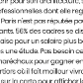
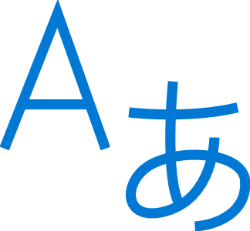

Knowledge mining with Azure Search
Documents
Cutting-edge AI
Fully text-searchable rich index
Key Phrase extraction
Location entity extraction
Sentiment analysis
Organization entity extraction
Persons entity extraction
Language detection
Face detection
Celebrity recognition
Tag extraction
Custom skills
Landmark detection
Printed text recognition

Slide 30
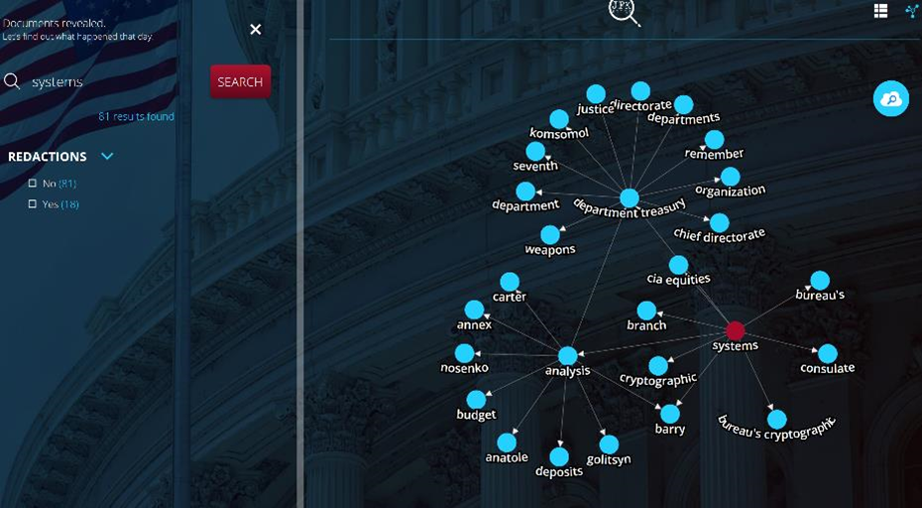
Knowledge mining Demo
JFK Files
https://jfk-demo.azurewebsites.net/

Slide 31
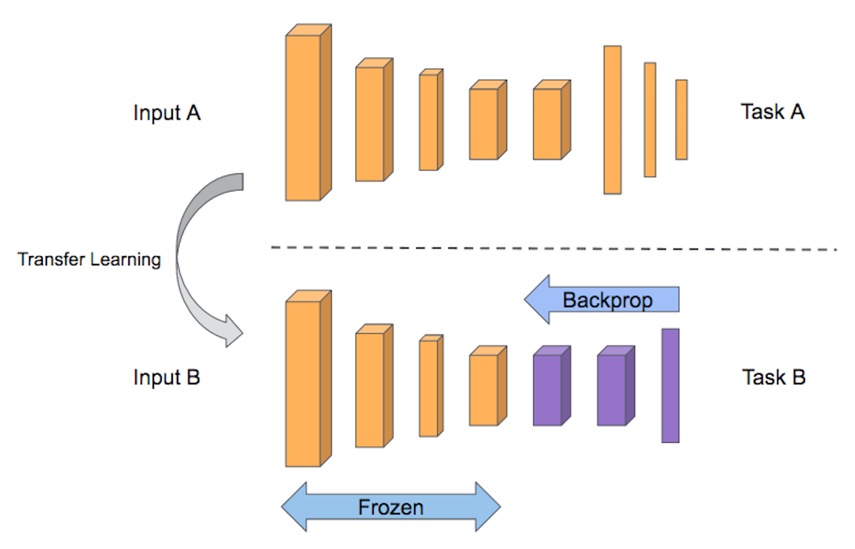
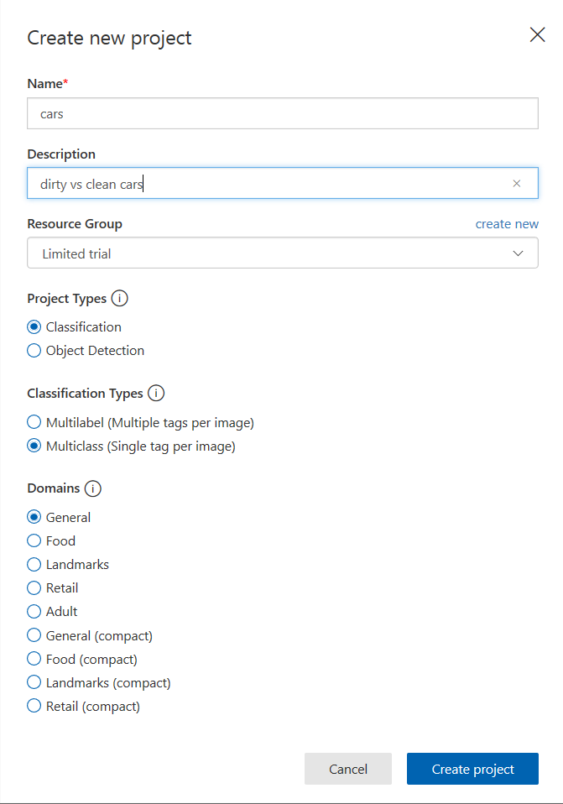
Cognitive Services API exercises
Image recognition
Go to: https://www.customvision.ai/
Sign in
Choose an image classification task
Create new project
Upload/tag images (5 images / tag)
Keep one extra image of each class to test
Train
Predictions / Quick Test
Transfer learning for DNNs:

Slide 32
Cognitive Services API exercises
Read handwritten text from images
Write a message on a piece of paper or the white board
Go to: https://azure.microsoft.com/en-us/services/cognitive-services/computer-vision/
Scroll down to Preview: Read handwritten text from images
Submit your picture

Slide 33
Cognitive Services challenges
Can I run a Custom Vision service model on my phone?
When would I not use Custom Vision? If I can’t use Custom Vision, what can I use in Azure, instead?
Can you set up a call to one of the Cognitive Service ReST API from your iPython notebook?

Slide 34
Azure Machine Learning Studio Exercises
Build a binary classification model
Portal>new>Azure Machine Learning Studio Workspace>create workspace
Inside of workspace>Launch Machine Learning Studio>sign in
Tour left side
Experiment>new>blank experiment
Tour left side
We’ll do this one together
Saved Datasets>Samples>Adult Census Income Binary Classification
Right-click>Dataset>Visualize
Search>split>Split Data
Search>boosted>Two-Class Boosted Decision Tree Model
Search>train>Train Model
Search>score>Score Model
Search>evaluate>Evaluate Model
Save/Run
Setup Web Service>Predictive Service
Run
Deploy Web Service Classic>Test Request/Response
50, Private, 200000, Bachelors, 16, Married-civ-spouse, Prof-specialty, Husband, White, Male, 0, 0, 40 United States
Result: … , ">50K","0.634786188602448"

Slide 35
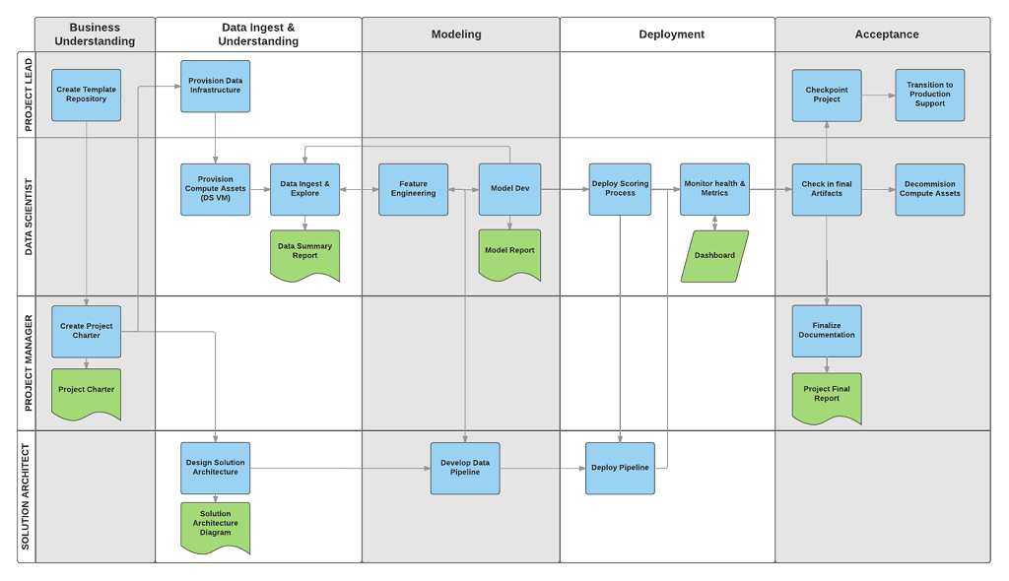

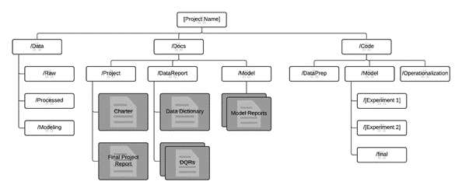
Data science is a team sport
Microsoft Team Data Science Process
http://aka.ms/tdsp

Slide 36
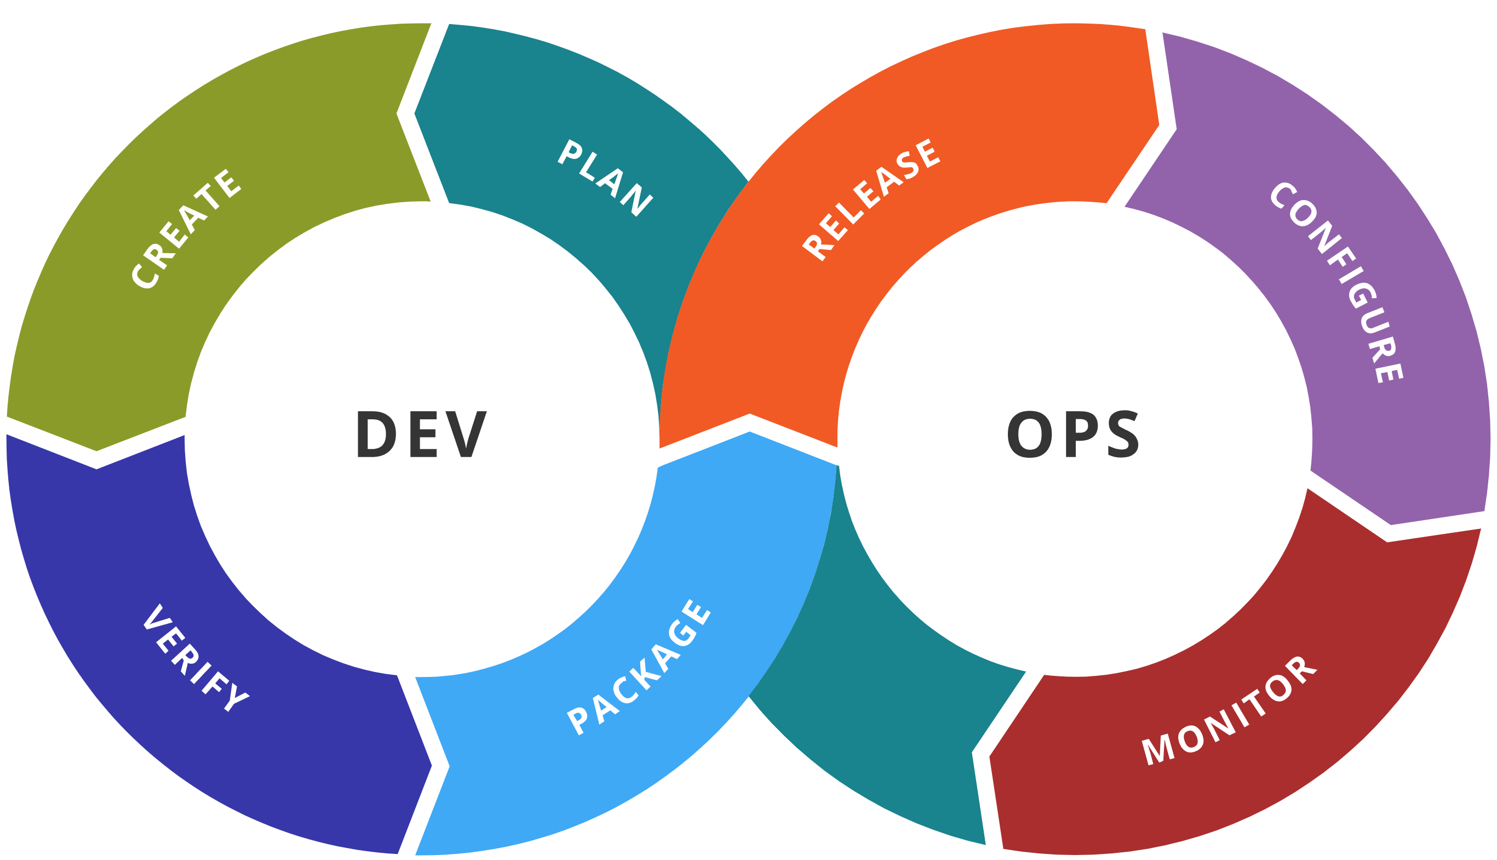
AI DevOps lifecycle
Experiment
Experiment
Data Acquisition
Business Understanding
Initial Modeling
Develop
Modeling
Operate
Continuous Delivery
Data Feedback Loop
System + Model Monitoring
+ Testing
Continuous Integration
Continuous Deployment

Slide 37
Key Goals of DevOps for AI
Repeatability of model creation & behavior
Evaluation of model predictions
Managing different model versions and files
Operationalization of the model
Monitoring of training and scoring pipelines

Slide 38





DevOps Framework for Azure AI Solutions
Plan and track
Code
Build and test
Deploy
Operate
Monitor
Boards
(Azure DevOps)
Repos
(Azure DevOps / GitHub)
Pipelines & Test Plans
(Azure DevOps)
Artifacts & Pipelines
(Azure DevOps)
Model monitoring
(Azure Machine
Learning Service)
Application
Insights
Training Pipelines (Azure ML)

Slide 39
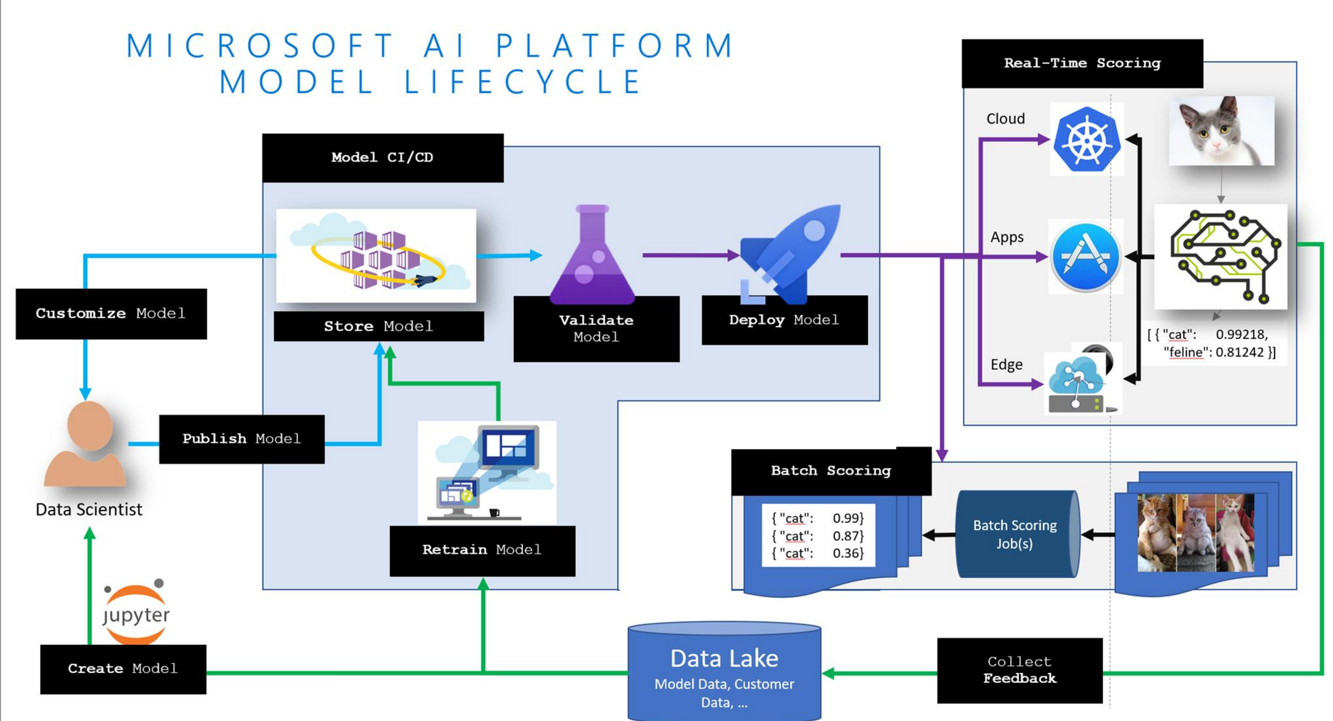
MLOps: Model Lifecycle

Slide 40




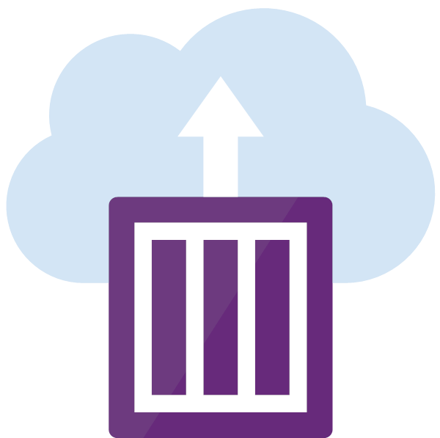

Integrated Pipeline for Data Scientists and Software Engineers
Data scientist
Experimentation Service – Train Model
Version
changes
Deploy (Test)
Code unit test
Data test
Train Model
Model sanity test
Model offline evaluation test
Deploy (Prod)
Version
changes
Integration test
Build pipeline
Software engineer

Slide 41



Q&A / Next steps
© Bill Watterson

